Slide 1
GRAPH PLOTTING APPLIACTAION USING PYTHON

Slide 2
INDEX
INTRODUCTION TO CONCEPT
OBJECTIVE
LITERATURE REVIEW
COMPONENTS AND TOOLS
PROCESS FLOW CHART
RESULTS
LIMITATIONS
FUTURE SCOPE

Slide 3
INTRODUCTION TO CONCEPT
Increasing online education results the students problem like improper visualization of gained knowledge at each and every subject .
TO solve this problem ,we introduce this app helping to visualize the mathematical graphs such as parabola, circle ,line, hyperbola, ellipse and higher degree polynomial in 2D and 3D using the python libraries.

Slide 4
OBJECTIVE
The proposed model focuses on visualization of the geometric diagrams in 2D ad 3D dimensions with different colors and coordinates to simplification and clear view about that figure, enhancing the ability students to have a clear conceptual knowledge of geometry, which would help them in their Engineering, BCs. Degrees.

Slide 5
LITERATURE REVIEW
NO | NAME OF ARTICAL | ADVANTAGE | DISADVANTAGE
1 | An Introduction to Making Scientific Publication Plots with Python | this system visualizes the wavelength like structures which is difficult to implants. | That model cannot implants the other geometric figures.
2 | Introduction to Data Visualization in Python | It implements bars like histogram and dots and wavelength structures. | It limits up to bars and cannot suppose to represent other diagrams.
3 | A Mathematical Graph Plotting App for Linux Desktop | we can manipulate the trigonometric graphs by this system with grace. | This app coordinates only with the Linux operating system only.
4 | PyChart – A Python module for analysis and visual view of 2D/3D Charts | The developed application is designated to visualize and explore 2D and 3D curves, including constant X, Y or Z chart intersection calculated through spline interpolation functions.

Slide 6
TOOLS USED
Python: The Application is based on Python Programming Language.
Matplotlib: In built Library of Python to use plotting utilities.
Tkinter: In built python Library for designing GUI.
NumPy: In Built python Library for Mathematical Calculations included in Graph Designing.
auto-py-to-exe: Python library for converting a python code into an executable application.

Slide 7
START
MATHEMATICAL GRAPHS
3D SURFACES
LINE GRAPHS
2D POLYNOMIAL
SLOPE INTERCEPT FORM
CIRCLES
SELECT NUMBER OF GRAPHS
PARAMETRIC GRAPHS
SLOPE TYPE
ENTER RADIUS
INTEGER
ANGLE
ENTER EQUATION OF GRAPHS
INTERCEPT
ELLIPSE
SELECT NUMBER OF GRAPHS
SLOPE POINT FORM
ENTER MAJOR, MINOR AXIS
RESIZE GRAPH
SLOPE TYPE
PARABOLA
RESET GRAPH
INTEGER
ANGLE
SELECT AXIS OF PARABOLA
COORDINATE OF REFERENCE POINT
MOVE GRAPH
SELECT COLOR OF GRAPH
TWO POINT FORM
HYPERBOLA
COORDINATE OF REFERENCE POINT 1
ENTER MAJOR, MINOR AXIS
ENTER ORIGIN
SAVE IMAGE OF GRAPH
COORDINATE OF REFERENCE POINT 2
INTERCEPT FORM
PLOT GRAPH
2D PLOTTING
X INTERCEPT
Y INTERCEPT
3D PLOTTING
END

Slide 8
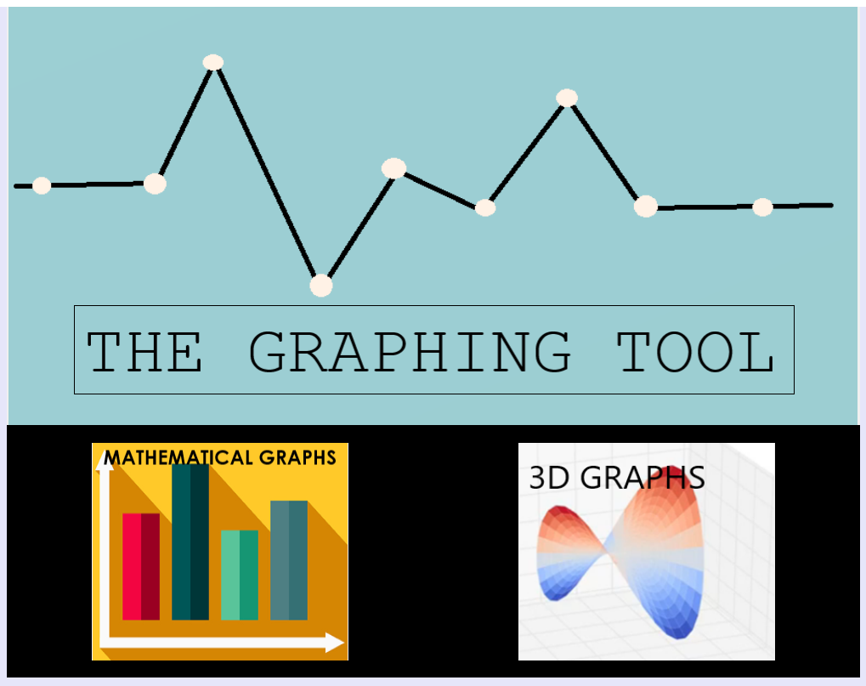
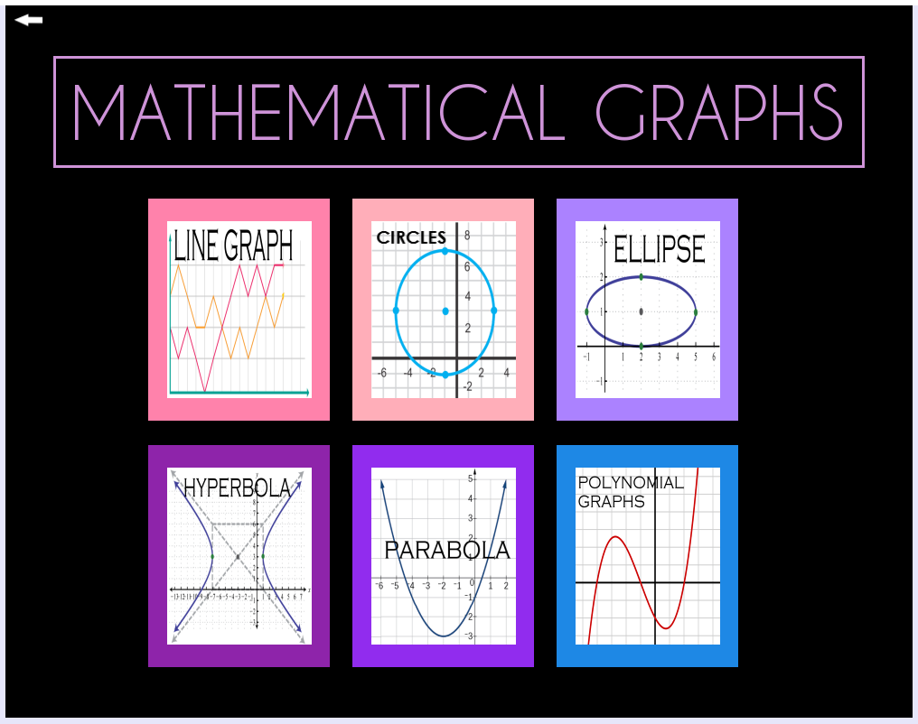
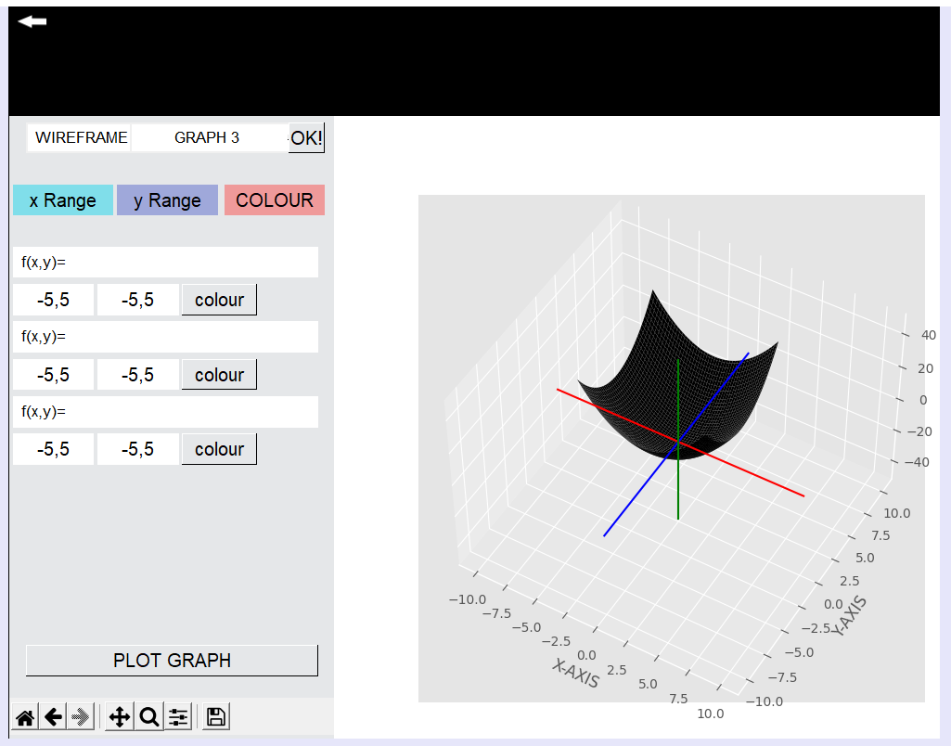
RESULTS

Slide 9
LIMITATIONS
Unable to plot multiple types of graphs on single canvas
Unable to plot csv based statistical graphs.
Simple Graphics.
Slow Processing.

Slide 10
FUTURE SCOPE
We can intersect the diagrams and visualize difficult situation of geometry.
We can plot statistical graph by including a separate csv module to insert the data
Introduce concepts as Extrapolation in Interpolation through simple graph plotting abilities.
Introduce Various Other such Development Tools Where the Simple Graphical Designing can be done.
Introduce Study Modules and Video sessions on plotting graphs with the help of Content creators helping students at free of cost from mediums as YouTube.

Slide 11
THANK YOUYOUTHANK YOU
REFERENCES:
https://towardsdatascience.com/introduction-to-data-visualization-in-python-89a54c97fbed
https://itsfoss.com/plots-graph-app/
https://iopscience.iop.org/article/10.1088/1742-6596/1781/1/012044/pdf
https://www.geeksforgeeks.org/visualize-graphs-in-python/?ref=rp

